Slide 1

RISK AND RESILIENCE BOOTCAMP
4

Slide 2


Slide 3
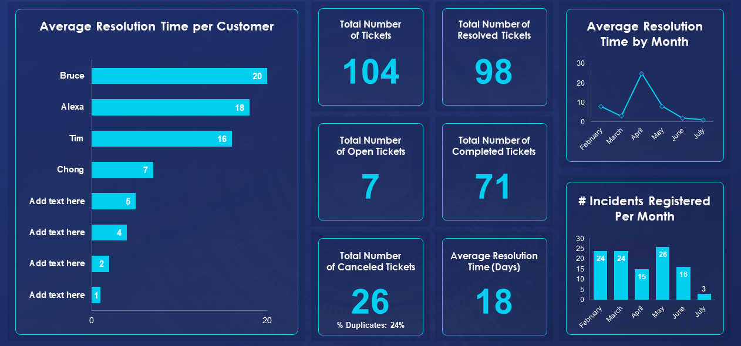
Risk Responses
This module is an overview on risk responses

Slide 4
Risk Responses
High-maturity risk programs
  Operate on the principle that speed and intelligence in decision-making directly influence the severity and spread of incidents
  In modern distributed architectures risk conditions evolve in minutes, not hours
Real-time monitoring and rapid escalation
  Ensure that organizations detect anomalies, evaluate them in context
  Then mobilize the right resources before risks escalate into operational failures or security breaches

Slide 5
Real-Time Decision Drivers
Real-time decisions are not made ad-hoc
  They are guided by predefined risk-driven criteria that ensure consistency, compliance, and clear prioritization
Severity classification (SEV-1 to SEV-4)
  Organizations classify incidents according to severity levels that determine urgency, staffing, and escalation paths
    SEV-1: Critical business-impacting outage or security breach. Required 24/7 immediate response
    SEV-2: Major functional impairment affecting customers or key workflows
    SEV-3: Limited impact or localized degradation
    SEV-4: Low priority; informational or minor anomaly
  Example
    If authentication API fails → SEV-1 (core service)
    If internal reporting dashboard slows → SEV-3

Slide 6
Real-Time Decision Drivers
Business impact mapping
  Driven by RTO, RPO, and criticality ratings from the BIA
  Systems with tight RTO/RPO require faster alerts and escalations
  Critical services (payments, trading platforms, identity providers) require immediate action even for small anomalies
  Non-critical services tolerate slower response
  Example
    A 200 ms latency spike in a real-time trading platform may trigger SEV-1
    A 15-minute delay in a batch report may not

Slide 7
Real-Time Decision Drivers
KRI thresholds (static and dynamic)
  Real-time KRIs use thresholds configured based on
    Static values (fixed limits, often regulatory or policy-based)
    Dynamic models (baselines, ML anomaly detection, z-scores)
  Examples
    Static: “Any encryption key reaching expiry within 7 days triggers escalation.”
    Dynamic: “Alert if login failure rate deviates >3σ from baseline.”

Slide 8
Real-Time Decision Drivers
Policy-defined escalations
Policies codify
  Who responds
  Within what timeframe
  What mandatory steps are required
  When escalation to senior leadership is required
  Which events must be logged for audit purposes
  Policies ensure decisions remain consistent, defensible, and compliant

Slide 9
Real-Time Decision Drivers
Regulatory reporting triggers
  Several regulations require near-real-time notification
    NY DFS Part 500: 72-hour notice for material cybersecurity events
    GDPR: 72-hour breach reporting
    PCI DSS: strict timelines for cardholder data incidents
    FFIEC: Operational resilience guidelines for financial institutions
  Real-time escalation frameworks must incorporate these deadlines, often requiring automatic flagging when regulatory thresholds are crossed

Slide 10
Real-Time Tools
SIEMs
  SIEM event correlation and detection
  SIEM = Security Information and Event Management
  SIEMs aggregate logs and security events
  Detect threats by correlating multiple signals
  Identify behavioral anomalies
  Trigger alerts when risk conditions exceed tolerance
  Example
    Combining IAM logs + network patterns can detect detect lateral movement

Slide 11
Real-Time Tools
SOAR
  Security Orchestration, Automation, and Response
  SOAR platforms automate routine responses
    Auto-block malicious IPs
    Quarantine compromised endpoints
    Trigger MFA challenges
    Enrich alerts with threat intel
    Escalate tickets to ServiceNow automatically
  This dramatically reduces MTTR and human workload

Slide 12
Real-Time Tools
Live responder mobilization
  Used for:
    Immediate on-call paging
    Multi-channel alerts (SMS, phone, push)
    Automated on-call rotations
    Incident commander activation
  Critical for SEV-1/SEV-2 incidents

Slide 13
Real-Time Tools
Telemetry-driven alerts
  Sample tools: CloudWatch, Datadog, Prometheus
  These platforms provide:
    Real-time metrics (CPU, IOPS, latency)
    Distributed tracing
    SLO/SLA monitoring
    Dynamic alerting based on baselines
  They detect operational risk events before they propagate

Slide 14
Real-Time Tools
Governance-driven escalation
  ServiceNow / Archer GRC
  These tools:
    Create incident or risk records
    Initiate GRC workflows (Governance, Risk, and Compliance)
    Manage evidence and documentation
    Track compliance-related escalations
    Enforce approvals and accountability
  They ensure that real-time response is also audit-ready

Slide 15
Escalation Framework
A high-maturity organization uses structured, hierarchical escalation to ensure the right people are engaged fast
  Tier 1: Initial triage
    Performs basic investigation (check logs, validate alerts)
    Filters false positives
    Assigns provisional severity
    Engages Tier 2 if needed
  Tier 2 : System/platform SMEs
    Deep technical analysis (containers, databases, identity, network)
    Offer architecture-level insights
    Own resolution of platform-specific issues

Slide 16
Escalation Framework
  Tier 3: Security analysts / senior engineers
    Lead investigation into sophisticated threats (malware, lateral movement, data exfiltration)
    Conduct forensic analysis
    Coordinate multi-team responses
    Make containment or shutdown decisions
  Leadership (CIO/CISO)
    Required for SEV-1 events and regulatory issues
    Decide on customer notifications, public communication, or legal actions
    May trigger Business Continuity or Disaster Recovery plans
  Regulators, regulatory notification is often mandatory when in a regulated industry there is
    Material customer impact
    Material data exposure
    Loss of key services
    Breaches of specific KRIs
    Security incidents affecting critical infrastructure
    Escalation to regulators is often time-bound and non-negotiable

Slide 17
Real-Time Decision-Making
  Context-aware alerts - asset criticality integration
  Alerts incorporate:
    Asset importance (tier-1 vs. tier-3 systems)
    Data sensitivity
    Business function mapping
    A CPU spike on a tier-3 staging server ≠ a CPU spike on a core payments service

Slide 18
Real-Time Decision-Making
  Dynamic alert suppression (noise reduction)
  High-maturity systems automatically suppress
    Repeated alerts
    Low-value anomalies
    Known benign patterns
    Flapping metrics
  This reduces “alert fatigue” and allows responders to focus on critical signals

Slide 19
Real-Time Decision-Making
  Threat correlation
    Weak signals may indicate a strong risk event
  Multiple low-severity anomalies might indicate
    Coordinated attack
    Insider threat behavior
    Critical system degradation
    Misconfigured infrastructure
  Examples
    Failed logins + unusual IP + privilege escalation attempt might indicate possible credential compromise
    Memory pressure + network latency + container restarts might indicate impending service outage

Slide 20
Real-Time Decision-Making
  AI-Assisted Decision Support
  Advanced platforms apply ML models to
    Predict severity based on historical patterns
    Suggest probable root causes
    Recommend containment actions
    Score risk levels in real time
    Identify correlated alerts across services
  This augments human expertise with intelligent prioritization

Slide 21

Q&A and open discussion
Notes:
Now is the time to engage in an interactive Q&A session where you can ask questions, share insights, and clarify any doubts about the topics we have covered so far.
This open discussion is designed to ensure that every participant has the opportunity to voice their thoughts and learn from the collective experience of the group.
Your questions and comments are valuable as they help us identify areas that may need further explanation and enable us to tailor future sessions to your needs.
We encourage you to speak up and contribute to the dialogue, as this interaction is one of the key components of our interactive learning approach.
As the session progresses, take note of any questions or ideas that you would like to revisit, and feel free to share your perspectives with the class.

